Slide 1
History of Mathematics
Pythagoras
&
Music of the Spheres

Slide 2
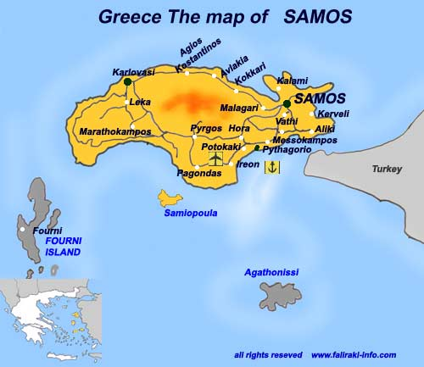
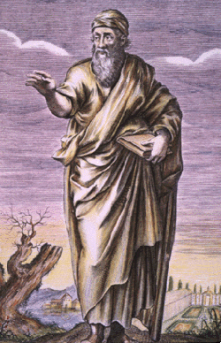
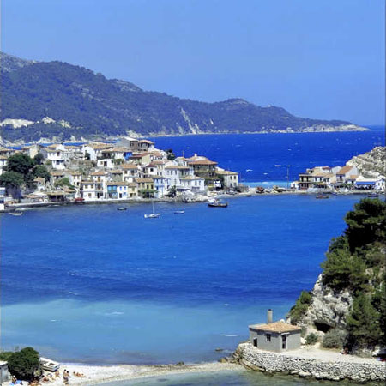
Pythagoras
We begin with the Greek island of Samos, the birthplace of Pythagoras, whose ideas dominate much early Greek mathematics.
A great deal of what has written about Pythagoras and his followers is more myth than historical fact. Keep in mind that we are talking about what possibly happened in the 5th Century BC and what is sometimes called the Pythagorean Tradition.

Slide 3
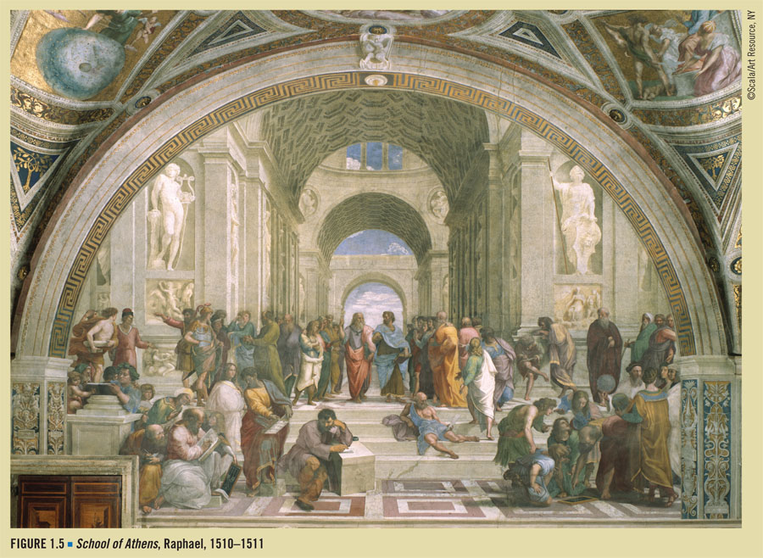
Euclid is shown with compass, lower right. We'll study soon Euclid’s Elements.
Socrates sprawls on the steps at their feet, the hemlock cup nearby.
His student Plato the idealist is on the left, pointing upwards to divine inspiration. He holds his Timaeus.
Plato's student Aristotle, the man of good sense, stands next to him. He is holding his Ethics in one hand and holding out the other in a gesture of moderation, the golden mean.

Slide 4
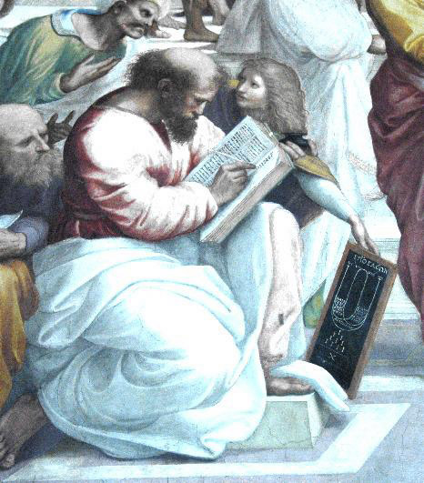
Pythagoras
Finally, we see Pythagoras (582?-500? BC), Greek philosopher and mathematician, in the lower-left corner.

Slide 5
The Pythagoreans
Pythagoras was born in Ionia on the island of Sámos, and eventually settled in Crotone, a Dorian Greek colony in southern Italy, in 529 B.C.E. There he lectured in philosophy and mathematics.
He started an academy which gradually formed into a society or brotherhood called the Order of the Pythagoreans.

Slide 6
The Pythagoreans
Disciplines of the Pythagoreans included:
Silence, music, incenses, physical and moral purifications, rigid cleanliness, a mild ascetisicm, utter loyalty, common possessions, secrecy, daily self-examinations (whatever that means), pure linen clothes.
We see here the roots of later monastic orders.

Slide 7
The Pythagoreans
For badges and symbols, the Pythagoreans had the Sacred Tetractys and the Star Pentagram. There were three degrees of membership:
novices or “Politics”
Nomothets, or first degree of initiation
Mathematicians
The Pythagoreans relied on oral teaching, perhaps due to their pledge of secrecy, but their ideas were eventually committed to writing. Pythagoras' philosophy is known only through the work of his disciples, and it's impossible to know how much of the "Pythagorean" discoveries were made by Pythagoras himself. It was the tradition of later Pythagoreans to ascribe everything to the Master himself.

Slide 8
Pythagorean Number Symbolism
The Pythagoreans adored numbers. Aristotle, in his Metaphysica, sums up the Pythagorean's attitude towards numbers.
"The (Pythagoreans were) ... the first to take up mathematics ... (and) thought its principles were the principles of all things. Since, of these principles, numbers ... are the first, ... in numbers they seemed to see many resemblances to things that exist ... more than [just] air, fire and earth and water, (but things such as) justice, soul, reason, opportunity ..."
The Pythagoreans knew just the positive whole numbers. Zero, negative numbers, and irrational numbers didn't exist in their system. Here are some Pythagorean ideas about numbers.

Slide 9
Masculine and Feminine Numbers
Odd numbers were considered masculine; even numbers feminine because they are weaker than the odd. When divided they have, unlike the odd, nothing in the center. Further, the odds are the master, because odd + even always give odd. And two evens can never produce an odd, while two odds produce an even.
Since the birth of a son was considered more fortunate than birth of a daughter, odd numbers became associated with good luck. "The gods delight in odd numbers," wrote Virgil.

Slide 10
Number Symbolism
1 Monad. Point. The source of all numbers. Good, desirable, essential, indivisible.
2 Dyad. Line. Diversity, a loss of unity, the number of excess and defect. The first feminine number. Duality.
3 Triad. Plane. By virtue of the triad, unity and diversity of which it is composed are restored to harmony. The first odd, masculine number.
4 Tetrad. Solid. The first feminine square. Justice, steadfast and square. The number of the square, the elements, the seasons, ages of man, lunar phases, virtues.
5 Pentad. The masculine marriage number, uniting the first female number and the first male number by addition.
The number of fingers or toes on each limb.
The number of regular solids or polyhedra.
Incorruptible: Multiples of 5 end in 5.

Slide 11
Number Symbolism
6 The first feminine marriage number, uniting 2 and 3 by multiplication.
The first perfect number (One equal to the sum of its parts, ie., exact divisors or factors, except itself. Thus, (1 + 2 + 3 = 6).
The area of a 3-4-5 triangle
7 Heptad. The maiden goddess Athene, the virgin number, because 7 alone has neither factors or product. Also, a circle cannot be divided into seven parts by any known construction.
8 The first cube.
9 The first masculine square.
Incorruptible - however often multiplied, reproduces itself.
10 Decad. Number of fingers or toes.
Contains all the numbers, because after 10 the numbers merely repeat themselves. The sum of the archetypal numbers (1 + 2 + 3 + 4 = 10)

Slide 12
Number Symbolism
27 The first masculine cube.
28 Astrologically significant as the lunar cycle.
It's the second perfect number (1 + 2 + 4 + 7 + 14 = 28).
It's also the sum of the first 7 numbers (1 + 2 + 3 + 4 + 5 + 6 + 7 = 28)!
35 Sum of the first feminine and masculine cubes (8+27)
36 Product of the first square numbers (4 x 9)
Sum of the first three cubes (1 + 8 + 27)
Sum of the first 8 numbers (1 + 2 + 3 + 4 + 5 + 6 + 7 + 8)

Slide 13
Figured Numbers
The Pythagoreans represented numbers by patterns of dots, probably a result of arranging pebbles into patterns. The resulting figures have given us the present word figures.
Thus 9 pebbles can be arranged into 3 rows with 3 pebbles per row, forming a square.
Similarly, 10 pebbles can be arranged into four rows, containing 1, 2, 3, and 4 pebbles per row, forming a triangle.
From these they derived relationships between numbers. For example, noting that a square number can be subdivided by a diagonal line into two triangular numbers, we can say that a square number is always the sum of two triangular numbers.
Thus the square number 25 is the sum of the triangular number 10 and the triangular number 15.

Slide 14
Sacred Tetraktys
One particular triangular number that they especially liked was the number ten. It was called a Tetraktys, meaning a set of four things, a word attributed to the Greek Mathematician and astronomer Theon (c. 100 CE). The Pythagoreans identified ten such sets.

Slide 15
Sacred Tetraktys
Numbers 1 2 3 4
Magnitudes Point Line Surface Solid
Elements Fire Air Water Earth
Figures Pyramid Octahedron Icosahedron Cube
Living Things Seed length breadth thickness
Societies Man Village City Nation
Faculties Reason Knowledge Opinion Sensation
Season Spring Summer Autumn Winter
Ages of a Person Infancy Youth Adulthood Old age
Parts of living things body Rationality Emotion willfulness

Slide 16
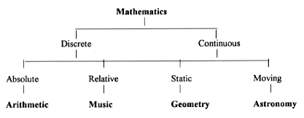
The Quadrivium
While speaking of groups of four, we owe another one to the Pythagoreans, the division of mathematics into four groups,
giving the famous Quadrivium of knowledge, the four subjects needed for a bachelor's degree in the Middle Ages.

Slide 17
Pythagoreans and music
The Pythagoreans in their love of numbers built up this elaborate number lore, but it may be that the numbers that impressed them most were those found in the musical ratios.
Lets start with a frontispiece from a 1492 book on music theory by F. Gaffurio

Slide 18
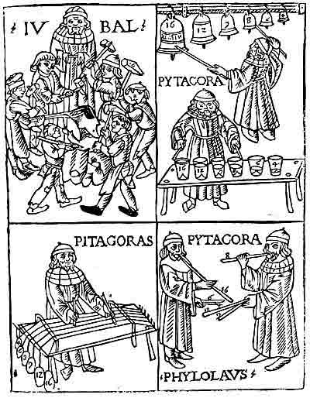
The upper left frame shows Lubal or Jubal, from the Old Testament, "father of all who play the lyre and the pipe" and 6 guys whacking on an anvil with hammers numbered 4, 6, 8, 9, 12, 16.
The frames in the upper right and lower left show Pithagoras hitting bells, plucking strings under different tensions, tapping glasses filled to different lengths with water, all marked 4, 6, 8, 9, 12, 16. In each frame he sounds the ones marked 8 and 16, an interval of 1:2 called the octave, or diapason.
In the lower right, he and Philolaos, another Pythagorean, blow pipes of lengths 8 and 16, again giving the octave, but Pythagoras holds pipes 9 and 12, giving the ratio 3:4, called the fourth or diatesseron while Philolaos holds 4 and 6, giving the ratio 2:3, called the fifth or diapente.

Slide 19
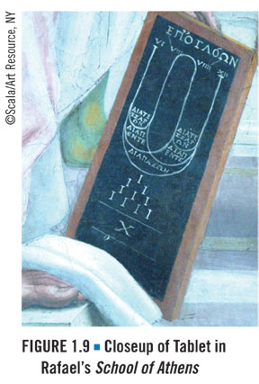
Musical Ratios
the Greek names for the musical ratios: diatessaron, diapente, diapason.
The Roman numerals for 6, 8, 9, and 12, which show the ratio of the musical ratios.
The word for the tone, EPOGLOWN, at the top.
Under the tablet is a triangular number 10 called the sacred tetractys, that we mentioned earlier.

Slide 20
 |  |  | Greek term | Latin term
6:12 | octave | (1:2) | diapson | duplus
6:9 or 8:12 | fourth | (2:3) | diapente | desquiltera
6:8 or 9:12 | fifth | (3:4) | diatessaron | sequitertia
8:9 | tone | (8:9) | tonus | sesquioctavus

Slide 21
Harmony
These were the only intervals considered harmonious by the Greeks. The Pythagoreans supposedly found them by experimenting with a single string with a moveable bridge, and found these pleasant intervals could be expressed as the ratio of whole numbers.

Slide 22
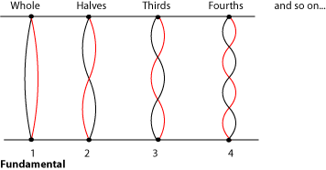
Vibrating String: why do some intervals sound pleasant and others discordant?
The fundamental pitch is produced by the whole string vibrating back and forth. But the string is also vibrating in halves, thirds, quarters, fifths, and so on, producing harmonics. All of these vibrations happen at the same time, producing a rich, complex, interesting sound.

Slide 23
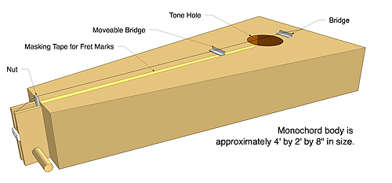
These are all integer ratios of the full string length, and it is these ratios that the Pythagoreans discovered with the monochord.

Slide 24
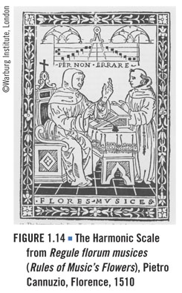
This title page shows a pattern similar to that one Pythagoras’ tablet in School of Athens, and also features compasses, which acknowledge a connection between music and geometry.

Slide 25
Now what…
Now we have a few pleasant sounding intervals, the tone, the fourth, the fifth, and the octave.
Starting at C, these intervals would give us F,G, and C, an octave higher than where we started.
What about the other notes depicted in Rules of Music’s Flowers?

Slide 26
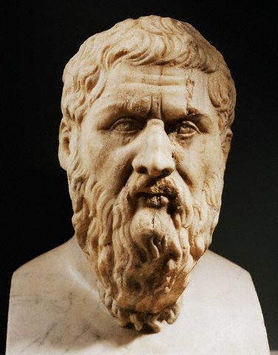
Plato
Plato (c.427-347 B.C.E.) was born to an aristocratic family in Athens. As a young man Plato had political ambitions, but he became disillusioned by the political leadership in Athens. He eventually became a disciple of Socrates, accepting his basic philosophy and dialectical style of debate, the pursuit of truth through questions, answers, and additional questions. Plato witnessed the death of Socrates at the hands of the Athenian democracy in 399 BC.

Slide 27
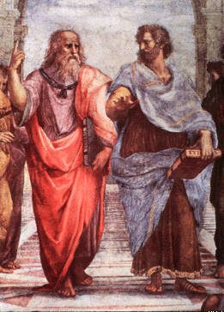
In Raphael's School of Athens we see Socrates prone, with cup nearby.
Plato's most prominent student was Aristotle, shown here with Plato in Raphael's School of Athens, Aristotle holiding his Ethics and Plato with his Timaeus.

Slide 28
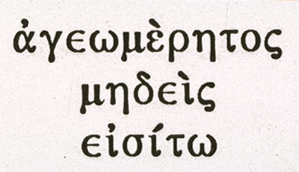
Plato's Academy
In 387 BCE Plato founded an Academy in Athens, often described as the first university. It provided a comprehensive curriculum, including astronomy, biology, mathematics, political theory, and philosophy.
Plato's final years were spent lecturing at his Academy and writing. He died at about the age of 80 in Athens in 348 or 347.
Over the doors to his academy were the words shown to the right meaning, "Let no one destitute of geometry enter my doors."

Slide 29
The Timaeus
Plato left lots of writings, but his love of geometry is especially evident in the Timaeus.
Written towards the end of Plato's life, c. 355 BCE, the Timaeus describes a conversation between Socrates, Plato's teacher, Critias, Plato's great grandfather, Hermocrates, a Sicilian statesman and soldier, and Timaeus, Pythagorean, philosopher, scientist, general, contemporary of Plato, and the inventor of the pulley. He was the first to distinguish between harmonic, arithmetic, and geometric progressions.
In this book, Timaeus does most the talking, with much homage to Pythagoras and echos of the harmony of the spheres, as he describes the geometric creation of the world.

Slide 30
Plato, through Timaeus, says that the creator made the world soul out of various ingredients, and formed it into a long strip. The strip was then marked out into intervals.
  First [the creator] took one portion from the whole (1 unit)
  next a portion double the first (2 unit)
  a third portion half again as much as the second (3 unit)
  the fourth portion double the second (4 unit)
  the fifth three times the third (9 unit)
  the sixth eight times the first (8 unit)
  the seventh 27 tmes the first (27 unit)
They give the seven integers; 1, 2, 3, 4, 8, 9, 27. These contain the monad, source of all numbers, the first even and first odd, and their squares and cubes.

Slide 31
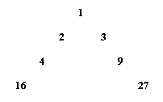
Plato's Lambda
These seven numbers can be arranged as two progressions. This is called Plato's Lambda, because it is shaped like the Greek letter lambda.

Slide 32
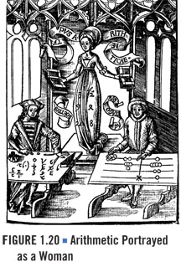
Plato’s Lambda
Plato’s Lambda appears in the allegory to arithmetic shown here.

Slide 33
Divisions of the World Soul as Musical Intervals
Relating this to music, if we start at low C and lay off these intervals, we get 4 octaves plus a sixth. It doesn't yet look like a musical scale. But Plato goes on to fill in each interval with an arithmetic mean and a harmonic mean. Taking the first interval, from 1 to 2, for example, Arithmetic mean = (1+2)/2 = 3/2
The Harmonic mean of two numbers is the reciprocal of the arithmetic mean of their reciprocals. For 1 and 2, the reciprocals are 1 and 1/2, whose arithmetic mean is 1+ 1/2 ÷ 2 or 3/4. Thus, Harmonic mean = 4/3
Thus we get the fourth or 4/3, and the fifth or 3/2, the same intervals found pleasing by the Pythagoreans. Further, they are made up of the first four numbers 1, 2, 3, 4 of the tetractys.

Slide 34
Filling in the Gaps
Plato took the geometric interval between the fourth and the fifth as a full tone. It is 3/2 ÷ 4/3 = 3/2 x 3/4 = 9/8
Plato then fills up the scale with intervals of 9/8, the tone. Starting at middle C, multiplying by 9/8 takes us to D, and multiplying D by 9/8 gives us E.
Multiplying E by 9/8 would overshoot F so he stopped. This leaves an interval of 256/243 between E & F. This ratio is approximately, equal to the half of the full tone, so it is called a semitone.

Slide 35
Summary
The fourths and fifths were found by arithmetic and harmonic means while the whole tone intervals were found by geometric means.
Thus Plato has constructed the scale from arithmetic calculations alone, and not by experimenting with stretched strings to find out what sounded best, as did the Pythagoreans.

Slide 36
So What?
So after experimenting with plucked strings the Pythagoreans discovered that the intervals that pleased people's ears were
octave 1 : 2 fifth 2 : 3 fourth 3 : 4
and we can add the two Greek composite consonances, not mentioned before . . .
octave plus fifth1 : 2 : 3 double octave1 : 2 : 4

Slide 37
And…
Now bear in mind that we're dealing with people that were so nuts about numbers that they made up little stories about them and arranged pebbles to make little pictures of them. Then they discovered that all of the musical intervals that they felt were beautiful, these five sets of ratios, were all contained in the simple numbers
1, 2, 3, 4
and that these were the very numbers in their beloved sacred tetractys that added up to the number of fingers. They must have felt they had discovered some basic laws of the universe.

Slide 38
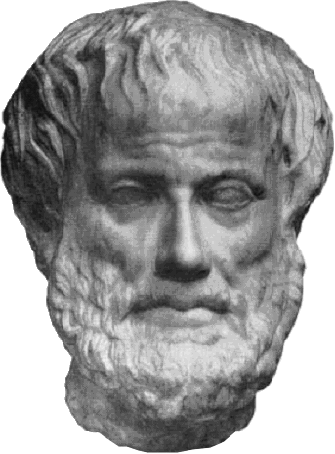
WOW!!
Quoting Aristotle "[the Pythagoreans] saw that the ... ratios of musical scales were expressible in numbers [and that] .. all things seemed to be modeled on numbers, and numbers seemed to be the first things in the whole of nature, they supposed the elements of number to be the elements of all things, and the whole heaven to be a musical scale and a number."

Slide 39
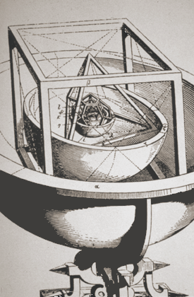
Music of the Spheres
"... and the whole heaven to be a musical scale and a number... "
It seemed clear to the Pythagoreans that the distances between the planets would have the same ratios as produced harmonious sounds in a plucked string. To them, the solar system consisted of ten spheres revolving in circles about a central fire, each sphere giving off a sound the way a projectile makes a sound as it swished through the air; the closer spheres gave lower tones while the farther moved faster and gave higher pitched sounds. All combined into a beautiful harmony, the music of the spheres.

Slide 40
Heavenly Music
This idea was picked up by Plato, who in his Republic says of the cosmos; ". . . Upon each of its circles stood a siren who was carried round with its movements, uttering the concords of a single scale," and who, in his Timaeus, describes the circles of heaven subdivided according to the musical ratios.
Kepler, 20 centuries later, wrote in his Harmonice Munde (1619) says that he wishes "to erect the magnificent edifice of the harmonic system of the musical scale . . . as God, the Creator Himself, has expressed it in harmonizing the heavenly motions.“ And later, "I grant you that no sounds are given forth, but I affirm . . . that the movements of the planets are modulated according to harmonic proportions."

